Slide 1
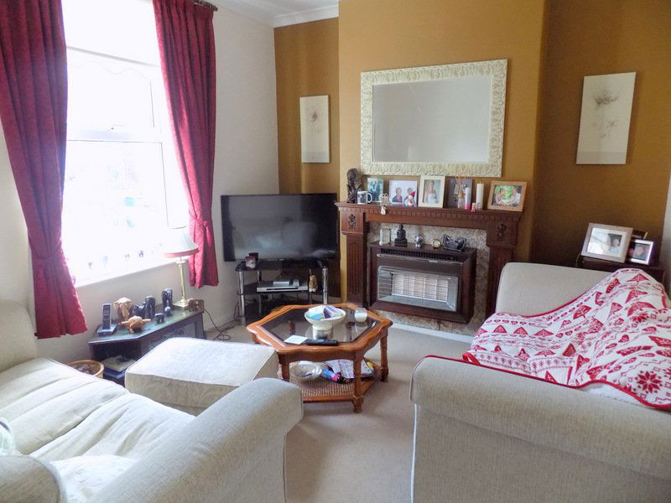
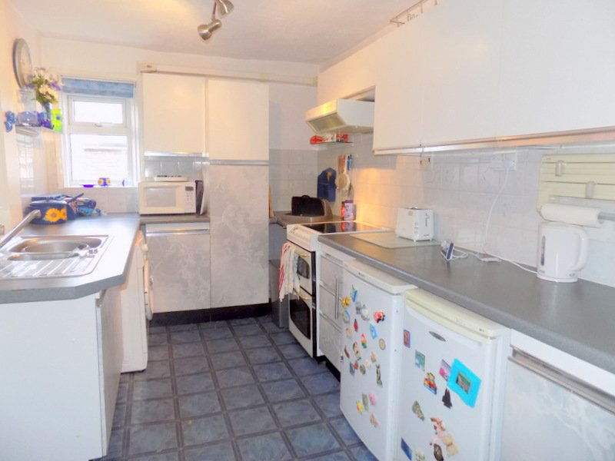
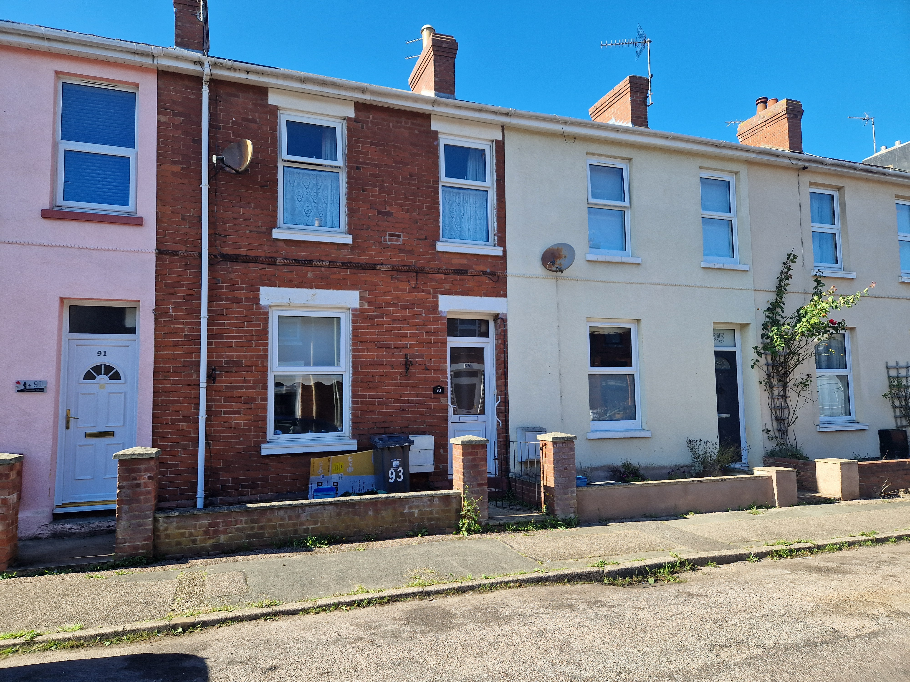
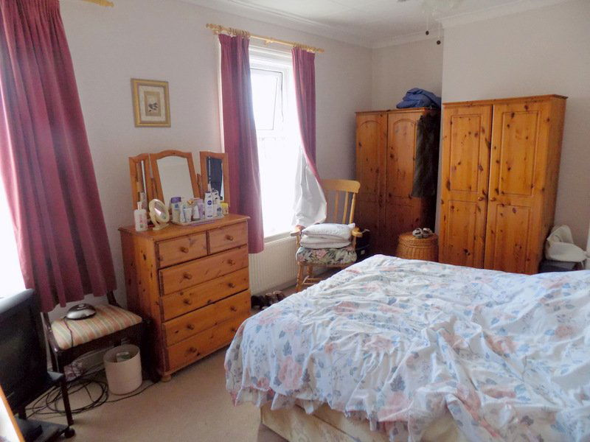
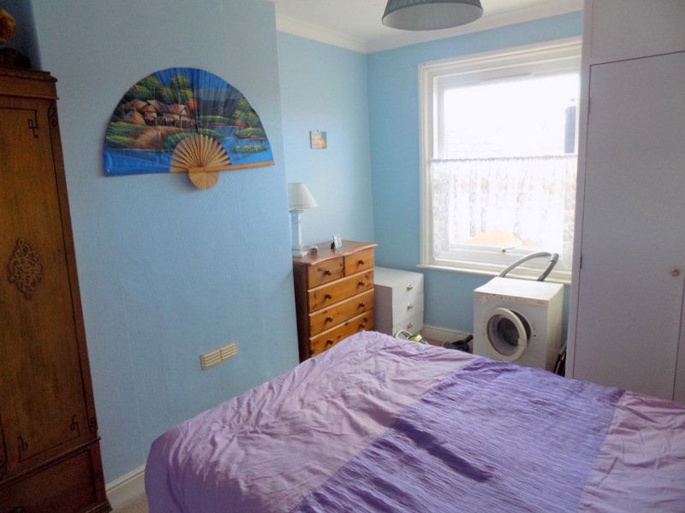
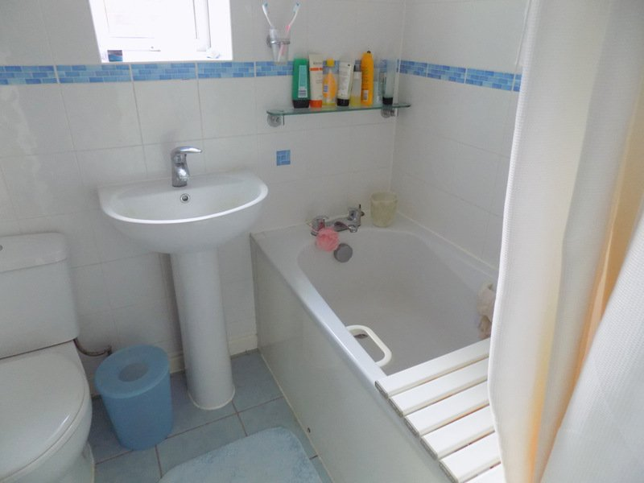
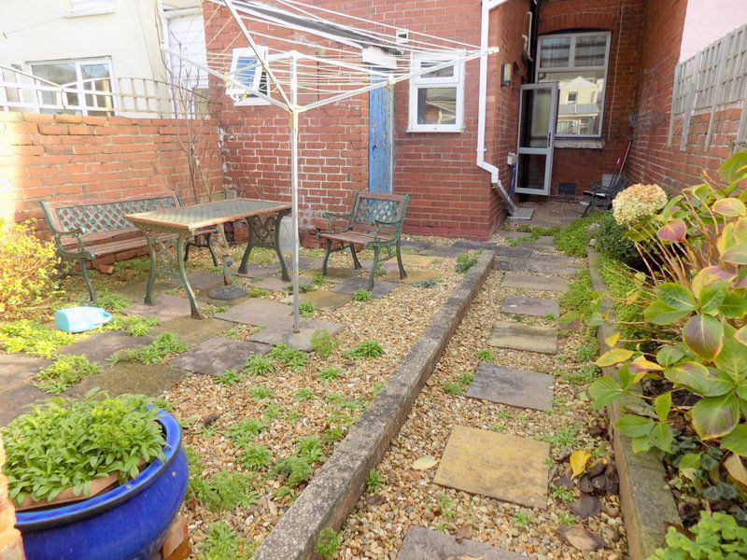
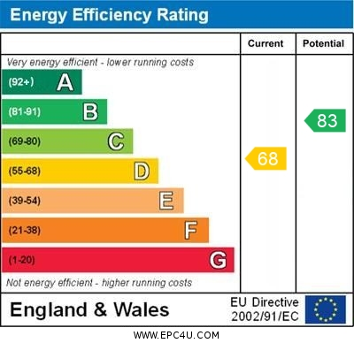
www.pennys.net
93 Egremont Road, Exmouth, Devon, EX8 1SA
GUIDE PRICE £225,000
TENURE Freehold
A Conveniently Located Three Bedroom Terraced House Within Easy Reach Of Amenities And The Town Centre
Entrance Vestibule And Reception Hall • Lounge • Dining / Family Room
Kitchen • Three First Floor Bedrooms • Bathroom / WC • Enclosed Rear Garden • Gas Central Heating Via Modern Boiler • Double Glazed Windows General Refurbishment Required
Pennys Estate Agents Limited for themselves and for the vendor of this property whose agents they are give notice that:- (1) These particulars do not constitute any part of an offer or a contract. (2) All statements contained in these particulars are made without responsibility on the part of Pennys Estate Agents Limited. (3) None of the statements contained in these particulars are to be relied upon as a statement or representation of fact. (4) Any intending purchaser must satisfy himself/herself by inspection or otherwise as to the correctness of each of the statements contained in these particulars. (5) The vendor does not make or give and neither do Pennys Estate Agents Limited nor any person in their employment has any authority to make or give any representation or warranty whatever in relation to this property.
PENNYS ESTATE AGENTS
2 Rolle House, Rolle Street, Exmouth, Devon, EX8 2SN
Tel: 01395 264111 EMail: help@pennys.net

Slide 2
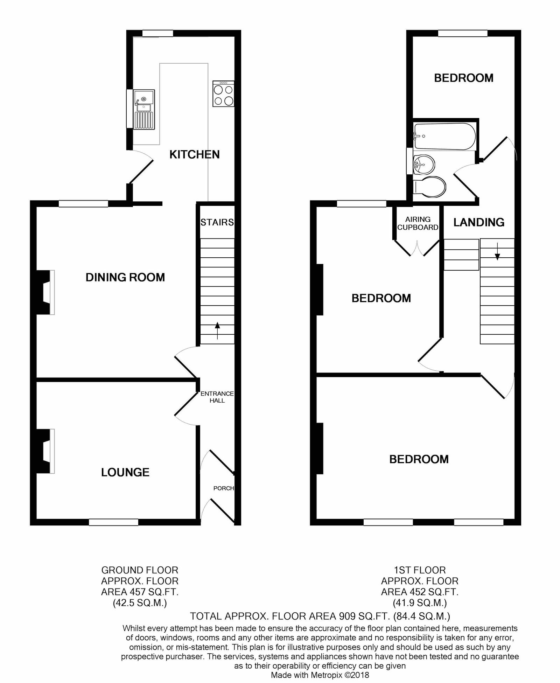
93 Egremont Road, Exmouth, EX8 1SA
THE ACCOMMODATION COMPRISES: UPVC double glazed front door with patterned glass giving access to: ENTRANCE VESTIBULE: With parquet flooring; pine tongue and groove walls; wall mounted cupboard housing meters; glazed panelled inner door with patterned glass leading to: RECEPTION HALL: With stairs rising to the first floor; radiator; doors to: LOUNGE: 11' 10" into wall recess x 10' 6" (3.61m x 3.2m) Double glazed window overlooking the front aspect; fitted gas fire housed in wooden fire surround; television point; coved ceiling. DINING / FAMILY ROOM: 13' 0" x 12' 2" (3.96m x 3.71m) Measurement excluding useful understair recess; fitted gas fire housed in wooden fire surround; radiator; coved ceiling; double glazed window to rear elevation. Door to: KITCHEN: 12' 9" x 8' 1" (3.89m x 2.46m) Fitted with a range of work surfaces with inset one and a quarter bowl single drainer sink unit with mixer tap over; range of cupboards, drawer units, space and plumbing for washing machine and appliance space beneath work surfaces; matching range of wall units at eye-level; electric cooker point with extractor hood over; upright larder style cupboard; tiled surrounds; double glazed window to side elevation and UPVC double glazed window to rear elevation; UPVC double glazed door with patterned glass giving access to outside. FIRST FLOOR SPLIT LEVEL LANDING: With access to roof space; coved ceiling; timer control for hot water and central heating; doors to: BEDROOM ONE: 15' 6" x 10' 7" (4.72m x 3.23m) Two UPVC double glazed windows to front elevation; radiator; television point; coved ceiling; electric fan light. BEDROOM TWO: 13' 3" x 9' 10" (4.04m x 3m) UPVC double glazed window to rear elevation; built-in linen cupboard housing the modern Worcester gas boiler serving domestic hot water and central heating and with slatted shelving. BEDROOM THREE: 9' 9" x 8' 0" (2.97m x 2.44m) maximum overall measurement. An 'L' Shaped room with UPVC double glazed window to rear elevation; radiator; picture rail. BATHROOM / WC: Fitted with a white suite comprising bath with handgrips and Mira shower unit over, shower curtain and rail; pedestal wash hand basin with chrome mixer tap; WC with push button flush; chrome heated towel rail with individual thermostat control; tiled flooring; fully tiled walls; extractor fan; UPVC double glazed window to side elevation. OUTSIDE: To the front of the property is a small garden enclosure with pedestrian gate giving access to the property. To the rear is a fully enclosed garden with patio sun terrace with decorative stone garden area; useful covered area adjoining the rear of the property and outside garden store with UPVC double glazed window.
Mortgage Assistance: We are pleased to recommend Meredith Morgan Taylor, who would be pleased to help no matter which estate agent you finally buy through. For a free initial chat please contact us on to arrange an appointment. Your home may be repossessed if you do not keep up repayments on your mortgage. Meredith Morgan Taylor Ltd is an appointed representative of The Openwork Partnership, a trading style of Openwork Ltd which is authorised and regulated by the Financial Conduct Authority (FCA).
FLOOR PLAN:

